Slide 1
Principles of learning and how they apply to training and teaching

Slide 2
Collaborative Document
http://bit.ly/311WWIy
Code of Conduct
We are all expected to follow a code of conduct:
https://docs.carpentries.org/topic_folders/policies/code-of-conduct.html

Slide 3
Introductions
Introductions set the stage for learning.
— Tracy Teal, Executive Director, The Carpentries

Slide 4




Introductions
Degree in Theoretical Physics
PhD in Bioinformatics
Training/Teaching
ELIXIR
Best practices in Software development
Software Carpentry
Carpentries Instructor Training
Learning processes/educational psychology
Cognitive sciences and learning
ELIXIR-EXCELERATE TtT programme
allegra.via@gmail.com
allegra.via
elixir_ita

Slide 5
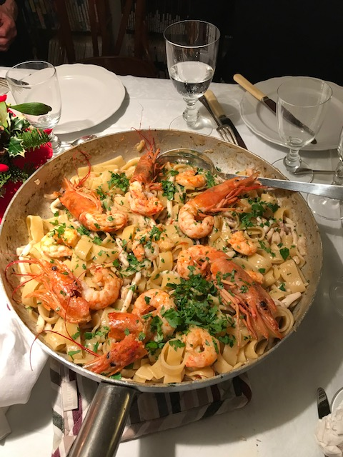

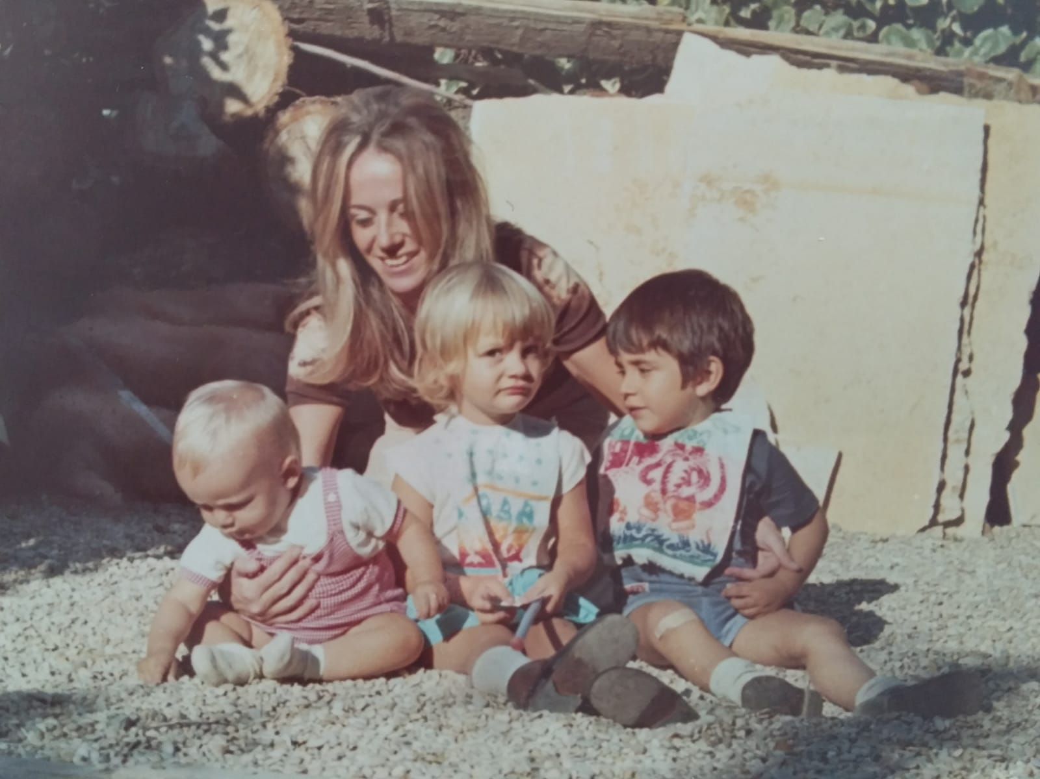


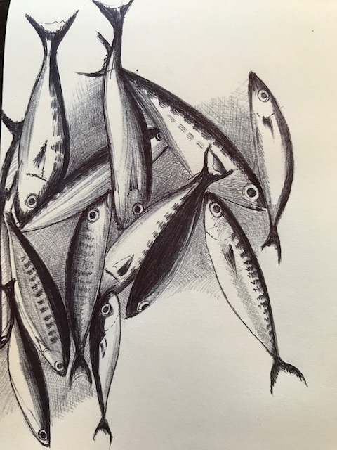



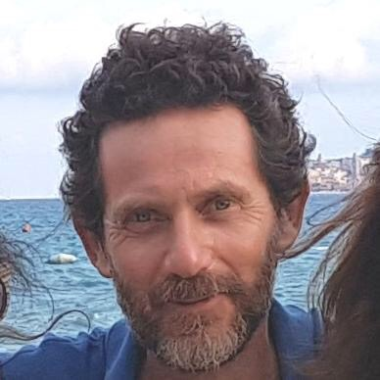
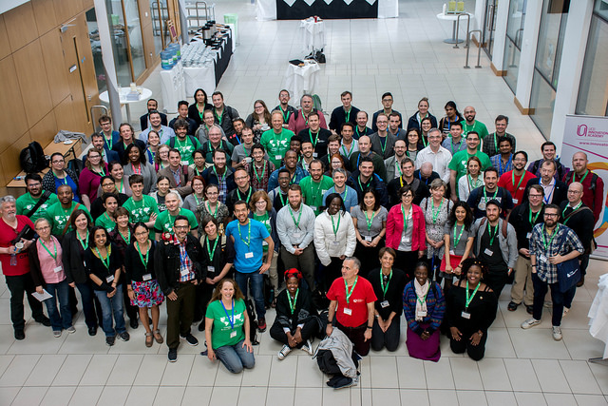



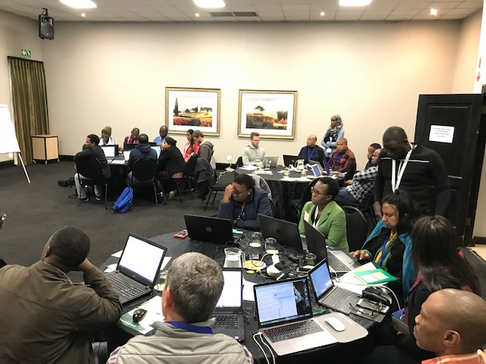

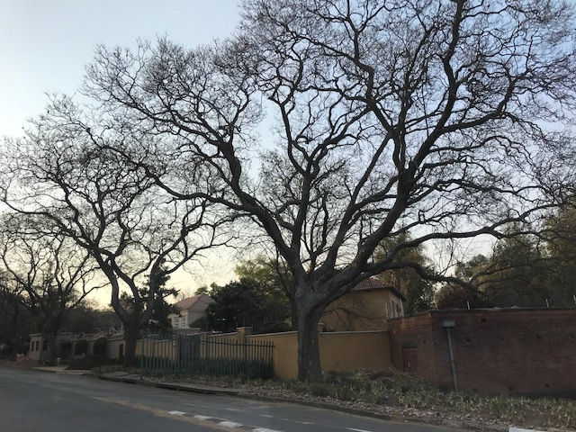



Slide 6
Challenge: your intro (3 min + 1 min for each of you)
Take 3 min to think about 3 keywords that represent you (could be adjectives, interests, research topics, personal characteristics, etc)
Introduce yourself telling us:
your name
your affiliation / country
The 3 keywords representing you
One thing you are proud of

Slide 7
Challenge: Your expectations
Write in the GDoc your expectations:
What do you expect to take home from this course?

Slide 8
Why are we here?
Principles of learning and how they apply to training and teaching
Training techniques to enhance learner participation and engagement
Design and plan lesson, session, course, materials
Assessment and feedback in training and teaching

Slide 9
Session 1: Principles of learning and how they apply to training and teaching
Episode 1: How do people learn?
Episode 2: How does learning progress?
Episode 3: What facilitiates and what hinders learning?

Slide 10
Episode 1: How do people learn?
How does learning work?
Terminology used in learning
What is learning?
Which learning theory?
7 Evidence-Based Learning Principles
Episode 2: How does learning progress?
The Bloom's six categories of cognitive skills
Declarative and procedural knowledge
Novices vs experts in learning
Adults vs children in learning
Episode 3: What facilitiates and what hinders learning?
Learners' prior knowledge and misconceptions
Working memory, long term memory and learning
What can we do to make room in working memory?
Cognitive load
Active learning
Motivation and demotivation

Slide 11
Episode 1: How do people learn?
How does learning work?
Terminology used in learning
What is learning?
Which learning theory?
7 Evidence-Based Learning Principles

Slide 12
Learning results from what the student does and thinks and only from what the student does and thinks. The teacher can advance learning only by influencing what the student does to learn
H.A. Simon (one of the founders of the field of Cognitive Science and Nobel Laureate)
1916-2001

Slide 13
How does learning work?
We cannot learn / improve teaching, teaching practices or effective teaching techniques if we don't understand first how people learn

Slide 14
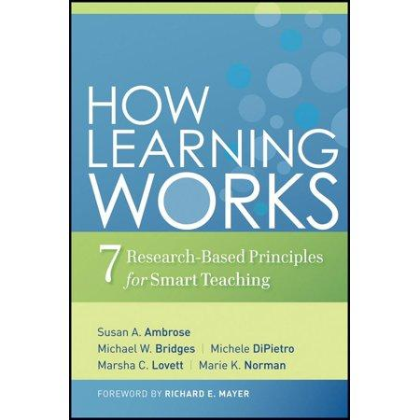
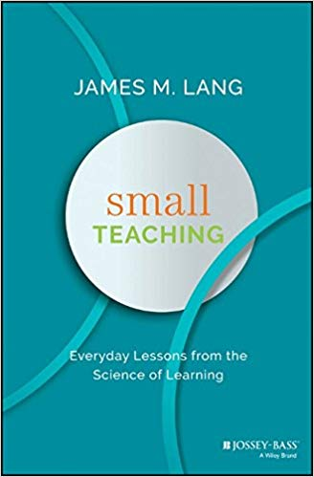

Resources to learn more about learning
the Carpentries instructor training materials
http://carpentries.github.io/instructor-training/

Slide 15
Terminology used in learning
Cognition and metacognition
Teaching and training
Teaching objectives (TO) and learning outcomes (LO)

Slide 16
Challenge (3 min + 5 min)
How do you go about learning something new ?
How do you approach learning new things?
Which is the most effective approach for you to learn?
- Read about it
- Attend a training session !
- Have a go ?
- Do, reflect, process, further understand?
Make a list of three approaches that work for you when you want to learn something new (from the most to the less effective one);
Discuss it with your partner and compare.

Slide 17
Challenge
What is learning in your opinion/experience? (5 min)
Discuss with a partner and write In the GDoc one or more definitions of what is learning in your opinion/experience

Slide 18
What is learning?
Ambrose et al. (2010) "How learning works"
Learning is not a product but a process occurring in the mind. As such, we can only infer that it has occurred from students' products or performance
Learning involves change in knowledge, beliefs, behaviours, or attitudes
Learning is not something done to students, but rather something students themselves do.
Willingham (2009) "Why don't students like school?"
Learning is a change in the long term memory

Slide 19
What is learning?
Ambrose et al. (2010) "How learning works"
Learning is not a product but a process occurring in the mind. As such, we can only infer that it has occurred from students' products or performance
Learning involves change in knowledge, beliefs, behaviours, or attitudes
earning is not something done to students, but rather something students themselves do.
Willingham (2009) "Why don't students like school?"
Learning is a change in the long term memory

Slide 20
What is learning?
Ambrose et al. (2010) "How learning works"
Learning is not a product but a process occurring in the mind. As such, we can only infer that it has occurred from students' products or performance
Learning involves change in knowledge, beliefs, behaviours, or attitudes
Learning is not something done to students, but rather something students themselves do.
Willingham (2009) "Why don't students like school?"
arning is a change in the long term memory

Slide 21
What is learning?
Ambrose et al. (2010) "How learning works"
Learning is not a product but a process occurring in the mind. As such, we can only infer that it has occurred from students' products or performance
Learning involves change in knowledge, beliefs, behaviours, or attitudes
Learning is not something done to students, but rather something students themselves do.
Willingham (2009) "Why don't students like school?"
Learning is a change in the long term memory

Slide 22
Which learning theory?
http://cmapspublic3.ihmc.us/rid=1LNV3H2J9-HWSVMQ-13LH/Learning%20Theory.cmap

Slide 24
Behaviourism
(started in the early 20th century by John Broadus Watson)
Learning is acquiring new behaviours by conditioning.
Reflex response to stimuli
Reward / Punishment

Slide 25
Cognitivism (started in 1920 by Jean Piaget):
Learning is based on the development of cognitive capabilities.
Its origin is in the Gestalt Psychologie («The whole is something else than the sum of its parts» - Kurt Koffka)

Slide 26
Connectivism
(started in the 1980s by Stephen Downes and George Siemens)
Knowledge is perceived from the environment and resides in connections.
No agents form connections better than a learner's brain itself.
The instructors act as facilitators. They create the environmental conditions that allow true learning to occur.

Slide 27
There is no universal theory of learning but a number of evidence-based research results supporting some learning principles, which are today accepted and applied in several communities of practice.

Slide 28
7 Evidence Based Learning Principles
Principle P1: Students' prior knowledge can help or hinder learning.
Principle P2: How students organise knowledge influences how they learn and apply what they know.
Principle P3: Students motivation determines, directs and sustains what they do learn.
Principle P4: To develop mastery, students must acquire component skills, practice integrating them, and know when to apply what they have learned

Slide 29
7 Evidence Based Learning Principles
Principle P5: Goal-directed practice coupled with targeted feedback enhances the quality of students' learning
Principle P6: Students' current level of development interacts with the social, emotional, and intellectual climate of the course to impact learning
Principle P7: To become self-directed learners, students must learn to monitor and adjust their approaches to learning.

Slide 30
What we have to be aware of in order to become better teachers
Teaching or training?
Adult learning or andragogy
The Bloom's six categories of cognitive skills
How thinking and memory work
The acquisition of skills: novices, competent practitioners, experts
Cognitive development and mental models
The importance of the learning environment
Active learning

Slide 31
Challenge: Teaching or Training? (3 +3 min)
Based on your experience, what are in your opinion the differences between teaching and training?
Make a list of two main differences
Write them in the GDoc
Discuss with your partner and share it with us

Slide 32
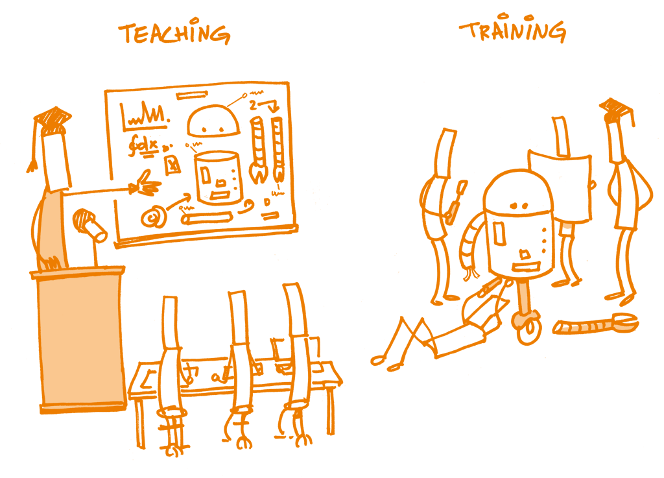
Open Science Training Handbook

Slide 33
Episode 2: How does learning progress?
The Bloom's six categories of cognitive skills
Learning outcomes (LO)
Writing Learning Outcomes using assessable verbs
Models of skill acquisition
Mental models
Novice vs Competent Practitioner

Slide 34
Bloom’s taxonomy
The Bloom's six categories of cognitive skills

Slide 35
Bloom’s taxonomy
Remember/Reiterate - performance is based on recognition of a seen example(s)
Understand/Summarize - performance summarizes information already known/given
Apply/Illustrate - performance extrapolates from seen examples to new ones by applying rules;
Analyze/Predict - performance requires analysis and prediction, using rules;
Create/ Synthesize - performance yields something innovative and novel, creating, describing and justifying something new from existing things/ideas;

Slide 36
We can use the Bloom's taxonomy to align instruction with learners' levels of complexity of thinking (and experience).
In practice, you can use the Bloom’s levels of cognitive complexity to:
write learning outcomes
design instruction and learning experiences
assess learning

Slide 37
Learning outcomes (LO)
LOs (more accurately “desired LOs”) are statements of what you might (in principle) assess.
You may not end up assessing all of them, but they are statements of what a student will know or be able to do, if they have learned everything in the course or session.

Slide 38
Writing Learning Outcomes using assessable verbs
Think about what learners will be able to do by the end of instruction
Use the sentence:
By the end of the lesson (session/course/instruction) the learner will be able to......... OR The successful learner will be able to......
Replace dots with a verb that you can assess (name, explain, solve, distinguish, etc.).
Avoid verbs that are open to many interpretations: e.g., appreciate, have faith in, know, learn, understand, believe

Slide 39
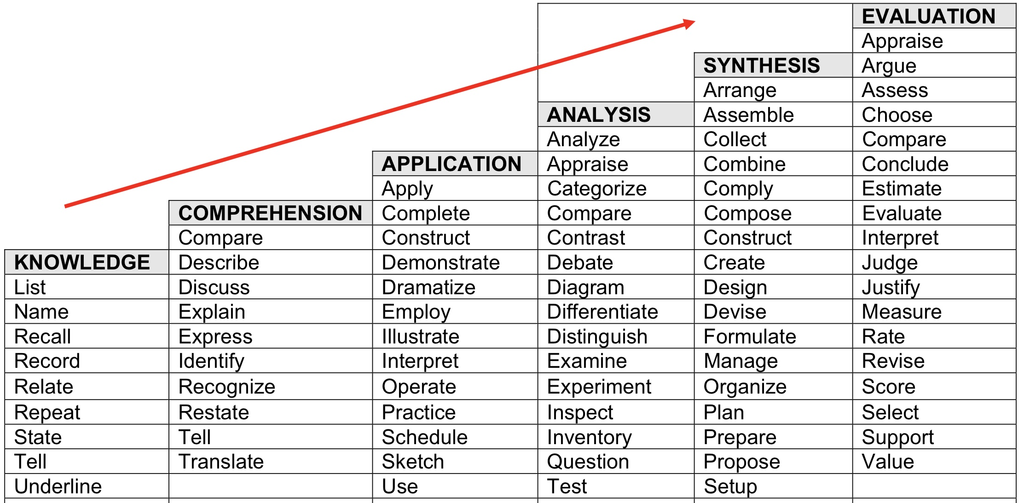
By the end of the lesson (session/course/instruction) the successful learner will be able to.........
Verbs that demonstrate Critical Thinking

Slide 40
Challenge (10 min)
Think of a lesson/session/course you usually deliver
Write one or more Learning Outcomes for the lesson/session/course
Write to the GDoc the title of the lesson/session/course and the corresponding LO(s)

Slide 41
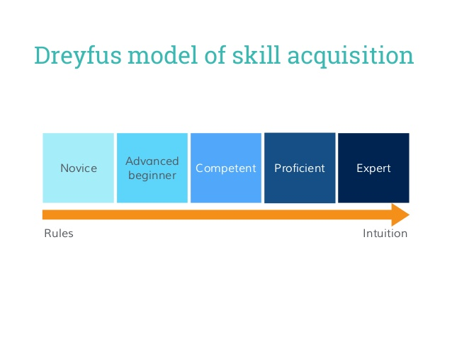

Slide 42
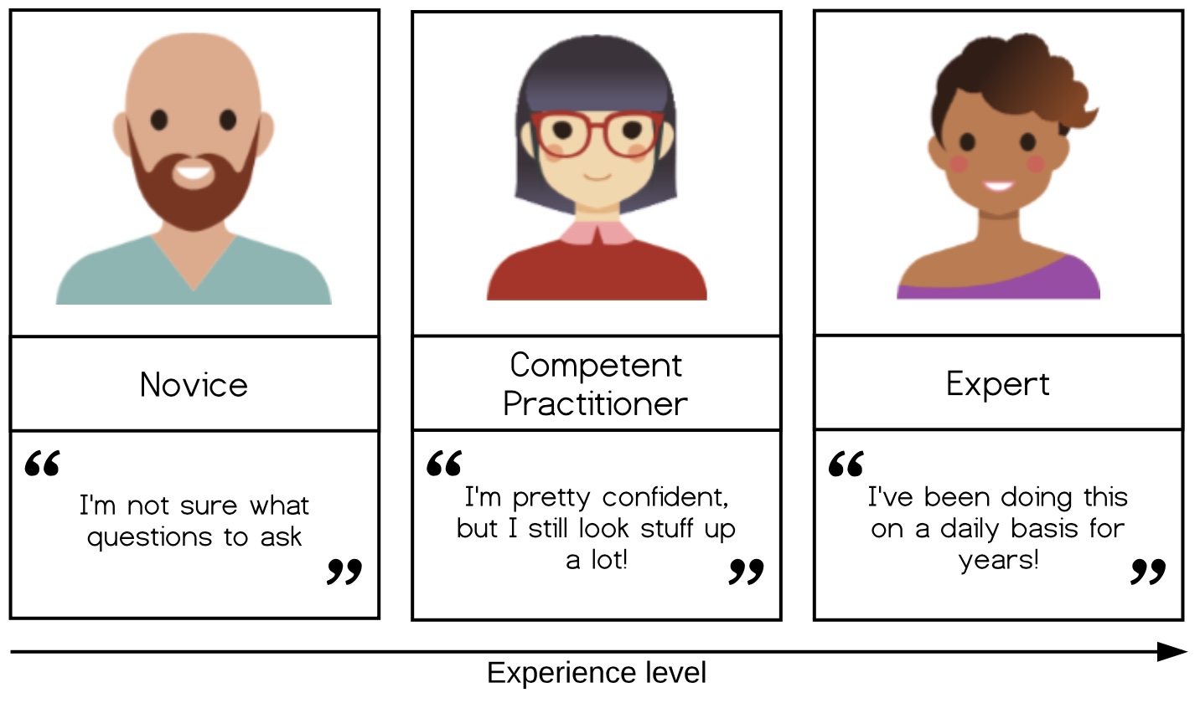
The Carpentries model of skill acquisition

Slide 43
The Carpentries model of skill acquisition
Novice: someone who doesn’t even know what questions to ask.
Competent practitioner: someone who has enough understanding for everyday purposes. They won’t know all the details of how something works and their understanding may not be entirely accurate, but it is sufficient for completing normal tasks with normal effort under normal circumstances.
Expert: someone who can easily handle situations that are out of the ordinary.

Slide 44
European Guild structure
Novice
Beginner
Apprentice
Journeyman

Slide 45
Challenge (5 min)
Think about
a topic/field you feel you are a novice
a topic you feel you are a competent practitioner
one you feel an expert
Share this with us in the GDoc.

Slide 46
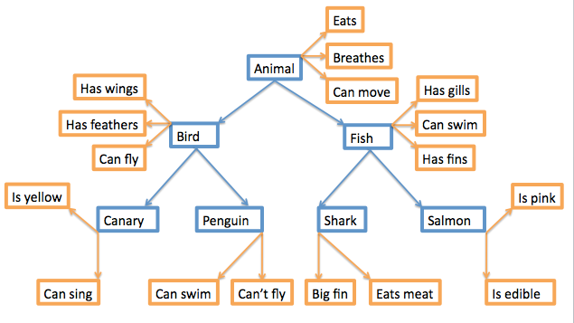
Mental models
A collection of concepts and facts, along with the relationships between those concepts, that a person has about a topic or field. It is how people organise their knowledge.
You can think of a graph with nodes (facts, concepts) and edges (connections).

Slide 47
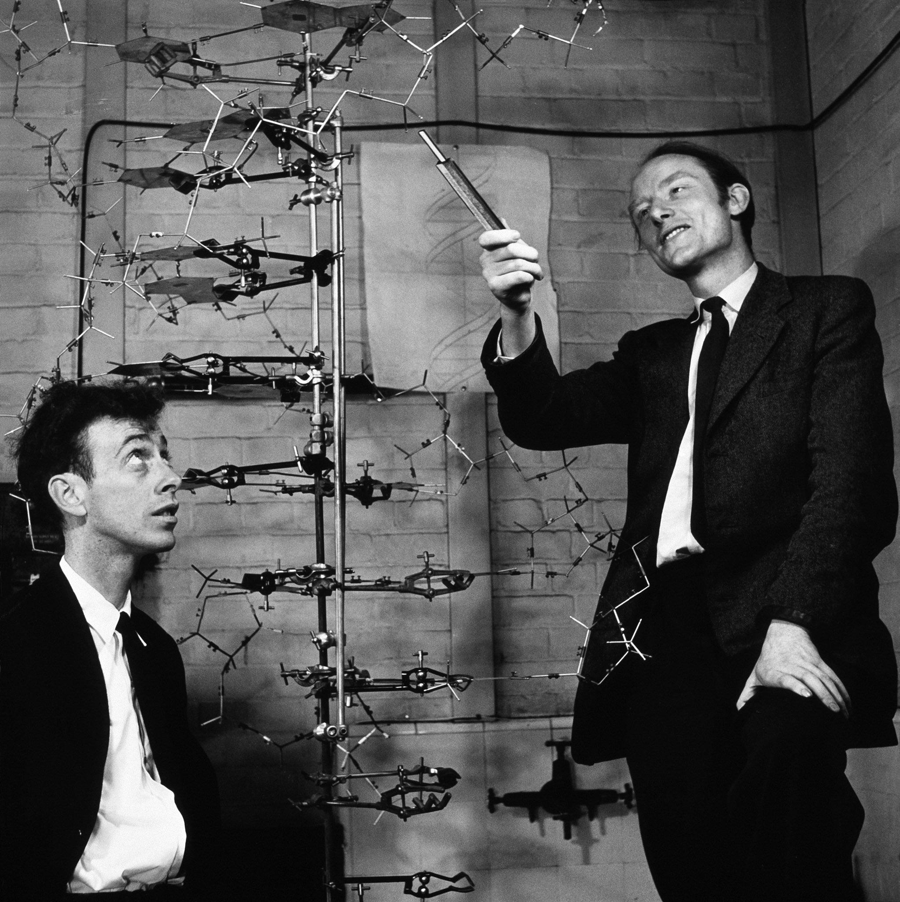

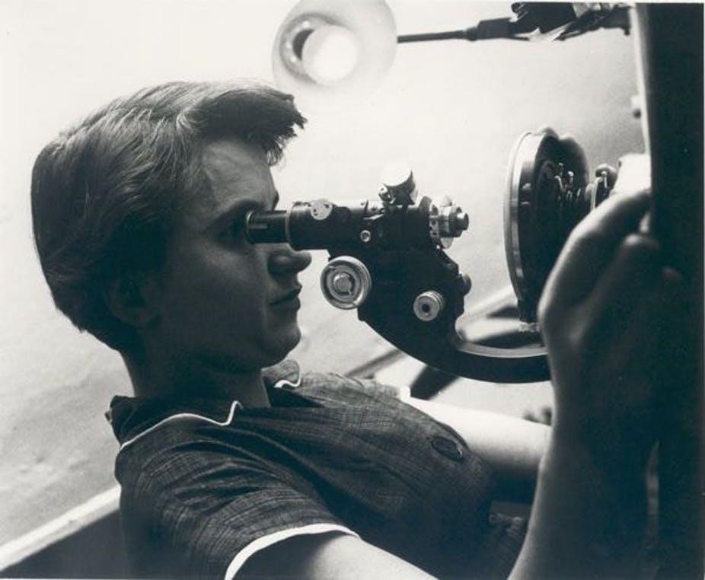
(mental) model of DNA

Slide 48
Challenge (10 min)
What are the main differences between a novice and an expert in terms of knowledge and learning?
How did you feel about something new when you were a student? How was to be a novice? Can you remember it? How do you feel today when you have/want to learn something completely new to you? (e.g. you decide you want to learn painting but have no clues about painting techniques and the theory of colours). Does it happen sometimes? How do you feel when you have to learn something new in your field? Namely, something that is an extension of your current knowledge about something.
Write at least two things in which novices and experts differ regarding knowledge.
Write at least two things in which novices and experts differ regarding learning.
Discuss with your partner(s)

Slide 49
Novice vs Competent Practitioner
A novice, typically has not yet built a mental model of the field.
A competent practitioner has a mental model that works for many purposes, but will not be very accurate.

Slide 50
Novice and expert knowledge organisations tend to differ in two key ways:
(i) the degree to which knowledge is sparsely versus richly connected
(ii) and the extent to which those connections are superficial versus meaningful.
Ambrose et al. in How learning works

Slide 51
Challenge: Adult learning or andragogy (10 min)
What learner are you today?
Think about your experience as a learner when you were at school, and now in this course;
Write one thing in which you feel different as a learner today from the learner you were at school;
Write it to the GDoc.

Slide 52
Compared to children, adults:
1. are internally motivated
2. prefer to be active in decisions relating to their learning
3. they bring a lot of prior knowledge and experience to learning
4. need to have new knowledge linked with existing information
5. are goal-oriented (so learning for learning's sake is unsatisfactory) * prefer learning what is authentic and directly relevant to their work or existing interests
6. are more practical learners, wanting to be able to apply what is learned
7. prefer to be treated as partners in the learning experience

Slide 53
Compared to children, adults:
1. are internally motivated
2. prefer to be active in decisions relating to their learning
3. they bring a lot of prior knowledge and experience to learning
4. need to have new knowledge linked with existing information
5. are goal-oriented (so learning for learning's sake is unsatisfactory) * prefer learning what is authentic and directly relevant to their work or existing interests
6. are more practical learners, wanting to be able to apply what is learned
7. prefer to be treated as partners in the learning experience

Slide 54
Compared to children, adults:
1. are internally motivated
2. prefer to be active in decisions relating to their learning
3. they bring a lot of prior knowledge and experience to learning
4. need to have new knowledge linked with existing information
5. are goal-oriented (so learning for learning's sake is unsatisfactory) * prefer learning what is authentic and directly relevant to their work or existing interests
6. are more practical learners, wanting to be able to apply what is learned
7. prefer to be treated as partners in the learning experience

Slide 55
Compared to children, adults:
1. are internally motivated
2. prefer to be active in decisions relating to their learning
3. they bring a lot of prior knowledge and experience to learning
4. need to have new knowledge linked with existing information
5. are goal-oriented (so learning for learning's sake is unsatisfactory) * prefer learning what is authentic and directly relevant to their work or existing interests
6. are more practical learners, wanting to be able to apply what is learned
7. prefer to be treated as partners in the learning experience

Slide 56
Compared to children, adults:
1. are internally motivated
2. prefer to be active in decisions relating to their learning
3. they bring a lot of prior knowledge and experience to learning
4. need to have new knowledge linked with existing information
5. are goal-oriented (so learning for learning's sake is unsatisfactory) * prefer learning what is authentic and directly relevant to their work or existing interests
6. are more practical learners, wanting to be able to apply what is learned
7. prefer to be treated as partners in the learning experience

Slide 57
Compared to children, adults:
1. are internally motivated
2. prefer to be active in decisions relating to their learning
3. they bring a lot of prior knowledge and experience to learning
4. need to have new knowledge linked with existing information
5. are goal-oriented (so learning for learning's sake is unsatisfactory) * prefer learning what is authentic and directly relevant to their work or existing interests
6. are more practical learners, wanting to be able to apply what is learned
7. prefer to be treated as partners in the learning experience

Slide 58
Compared to children, adults:
1. are internally motivated
2. prefer to be active in decisions relating to their learning
3. they bring a lot of prior knowledge and experience to learning
4. need to have new knowledge linked with existing information
5. are goal-oriented (so learning for learning's sake is unsatisfactory) * prefer learning what is authentic and directly relevant to their work or existing interests
6. are more practical learners, wanting to be able to apply what is learned
7. prefer to be treated as partners in the learning experience

Slide 59
Episode 3: What facilitates and what hinders learning?
Learners' prior knowledge and misconceptions
Working memory, long term memory and learning
What can we do to make room in working memory?
Cognitive load
Active learning
Motivation and demotivation

Slide 60
Learners' prior knowledge and misconceptions
Principle P1: Students' prior knowledge can help or hinder learning.
Principle P2: How students organise knowledge influences how they learn and apply what they know.

Slide 61
3 main classes of misconceptions
Simple factual errors: These are the easiest to correct.
Broken models: We can address these by having learners reason through examples to see contradictions.
Fundamental beliefs: These beliefs are deeply connected to the learner’s social identity and are the hardest to change.

Slide 62
Exposing misconceptions
Misconceptions can be managed through reflective practice, i.e. practice followed by feedback (formative assessment) followed by further practice.

Slide 63
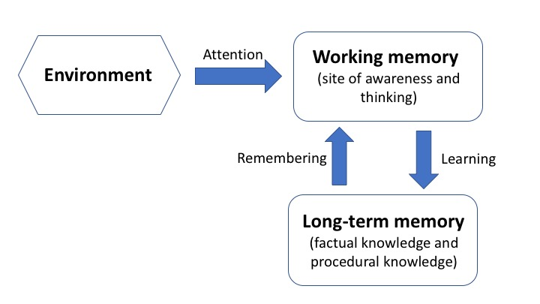
Working memory, long term memory and learning

Slide 64
Working memory, long term memory and learning
Full of things to see and hear, problem to be solved etc.

Slide 65
Working memory, long term memory and learning
Component of your mind (synonymous of consciousness). It is where thinking occurs. It is the part of your mind where you are aware of what is around you.
Full of things to see and hear, problem to be solved etc.

Slide 66
Working memory, long term memory and learning
Component of your mind (synonymous of consciousness). It is where thinking occurs. It is the part of your mind where you are aware of what is around you.
Full of things to see and hear, problem to be solved etc.
Vast storehouse in which you mantain your factual knowledge of the world. Information in long-term memory resides outside of awareness.

Slide 67
Working memory, long term memory and learning
Very fast but has very limited space. Several experiments showed that we can hold in the working memory up to 7 +/- 2 items.

Slide 68
Working memory, long term memory and learning
Long-term memory is slow to access but it is essentially unbounded

Slide 69
Challenge: short term memory
Try to remember following words:
Tree, Dance, House, Airport, Sugar, Child, Ground, Watch, Squirrel, Truck, Building, Hospital, Pencil, Terrace, Lamp
Now, write them down

Slide 70
Challenge: short term memory
How many words do you remember?

Slide 71
Challenge: (Willingham, 2009):
How many consecutive letters can you remember?
X C N
N P H
D F B
I C I
A N C
A A X

Slide 72
Challenge: (Willingham, 2009):
How many consecutive letters can you remember?
write them down

Slide 73
Challenge: (Willingham, 2009):
What about now?
X
C N N
P H D
F B I
C I A
N C A A
X

Slide 74
Challenge: (Willingham, 2009):
How many consecutive letters can you remember?
write them down

Slide 75
The amount of space in working memory does not depend on the number of letters; it depends on the number of meaningful objects.

Slide 76
What can we do to make room in working memory?
Increase our background knowledge
Chunking
Avoid extraneous cognitive load

Slide 77
Avoid extraneous cognitive load
Intrinsic cognitive load is the effort associated with a specific topic.
Germane cognitive load refers to the work put into creating a permanent store of knowledge, or a schema. It is the (desirable) mental effort required to create linkages between new information and old (which is one of the things that distinguishes learning from memorization)
Extraneous cognitive load is everything else that distracts or gets in the way. Extraneous cognitive load refers to the way information or tasks are presented to a learner.

Slide 78
Attention split effect

Slide 79
Challenge: Extraneous cognitive load (10 min)
Think of the tasks you teach in your lessons/courses. Pick one.
What would be the extraneous load in performing this task. How can you avoid it?
Discuss with your partner(s).

Slide 80
Other factors facilitating memory and learning (Willingham, 2009)
1. things that create an emotional reaction will be better remembered, but emotion is not necessary for learning (and it is definitely not sufficient!)
2. if you don't pay attention to something, you can't learn it
3. repetition helps but repetition alone is not sufficient
4. wanting to remember something has little or no effect
5. thinking about meaning is good for memory
6. practice makes learning long lasting
7. spaced practice is of great benefit for memory

Slide 81
Other factors facilitating memory and learning (Willingham, 2009)
1. things that create an emotional reaction will be better remembered, but emotion is not necessary for learning (and it is definitely not sufficient!)
2. if you don't pay attention to something, you can't learn it
3. repetition helps but repetition alone is not sufficient
4. wanting to remember something has little or no effect
5. thinking about meaning is good for memory
6. practice makes learning long lasting
7. spaced practice is of great benefit for memory

Slide 82
Other factors facilitating memory and learning (Willingham, 2009)
1. things that create an emotional reaction will be better remembered, but emotion is not necessary for learning (and it is definitely not sufficient!)
2. if you don't pay attention to something, you can't learn it
3. repetition helps but repetition alone is not sufficient
4. wanting to remember something has little or no effect
5. thinking about meaning is good for memory
6. practice makes learning long lasting
7. spaced practice is of great benefit for memory

Slide 83
Other factors facilitating memory and learning (Willingham, 2009)
1. things that create an emotional reaction will be better remembered, but emotion is not necessary for learning (and it is definitely not sufficient!)
2. if you don't pay attention to something, you can't learn it
3. repetition helps but repetition alone is not sufficient
4. wanting to remember something has little or no effect
5. thinking about meaning is good for memory
6. practice makes learning long lasting
7. spaced practice is of great benefit for memory

Slide 84
Other factors facilitating memory and learning (Willingham, 2009)
1. things that create an emotional reaction will be better remembered, but emotion is not necessary for learning (and it is definitely not sufficient!)
2. if you don't pay attention to something, you can't learn it
3. repetition helps but repetition alone is not sufficient
4. wanting to remember something has little or no effect
5. thinking about meaning is good for memory
6. practice makes learning long lasting
7. spaced practice is of great benefit for memory

Slide 85
Other factors facilitating memory and learning (Willingham, 2009)
1. things that create an emotional reaction will be better remembered, but emotion is not necessary for learning (and it is definitely not sufficient!)
2. if you don't pay attention to something, you can't learn it
3. repetition helps but repetition alone is not sufficient
4. wanting to remember something has little or no effect
5. thinking about meaning is good for memory
6. practice makes learning long lasting
7. spaced practice is of great benefit for memory

Slide 86
Other factors facilitating memory and learning (Willingham, 2009)
1. things that create an emotional reaction will be better remembered, but emotion is not necessary for learning (and it is definitely not sufficient!)
2. if you don't pay attention to something, you can't learn it
3. repetition helps but repetition alone is not sufficient
4. wanting to remember something has little or no effect
5. thinking about meaning is good for memory
6. practice makes learning long lasting
7. spaced practice is of great benefit for memory

Slide 87
Active learning
Learners who actively engage with course materials will end up retaining it for much longer than they would have otherwise, and they will be better able to apply their knowledge broadly.
Waldrop, Nature 2015
Strategies for active learning?

Slide 88
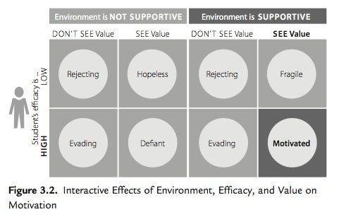
Motivation and demotivation

Slide 89
Mazur's video on Peer Instruction for Active Learning

Slide 90
Time to relax

Slide 91
Teaching
A process of educating a person with theoretical concepts and is a kind of a knowledge transfer between a teacher and a student. The role of the teacher is to act as a facilitator of learning by leading discussions, providing opportunities to ask open-ended questions, guiding the processes and tasks and enabling the active participation of learners and to engage with ideas.

Slide 92
Training
Training is an approach used in short and intensive courses to build a person’s skills, knowledge and attitudes on a specific subject. Even though the person has attained the highest academic qualifications, still she may want or need to acquire specific knowledge and skills on a given topic.

Slide 93
Objectives
Are statements of what you are setting out to teach, although expressed as if the students were going to learn it.
Despite Aims are usually intended to be more general and encompassing than Objectives, they are essential the same.

Slide 94
Environment: full of things to see and hear, problem to be solved etc.
Working memory: component of your mind (synonymous of consciousness). It is where thinking occurs. It is the part of your mind where you are aware of what is around you.
Long-term memory: vast storehouse in which you maintain your factual knowledge of the world. Information in long-term memory resides outside of awareness.

Slide 95
Working memory is very fast but has very limited space. Several experiments showed that we can hold in the working memory up to 7 +/- 2 items.
Long-term memory is slow to access but it is essentially unbounded.

Slide 96
efficient bioinformatics training in non-formal way
It provides essentially skills, rather than deep knowledge
It aims at the acquisition of competences
It must focus on the learner (learner-centric)
It must guarantee that independently reproducible outcomes are obtained
The learners must acquire autonomy (skills usage independence)

